Slide 1


Bilibili - ( ° - °)つロ Cheers
Notes:
Bilibili
Background

Slide 2


loading

Slide 3


With Reference to Bilibili, discuss how innovation and Ethics may influence marketing practices.

Slide 4
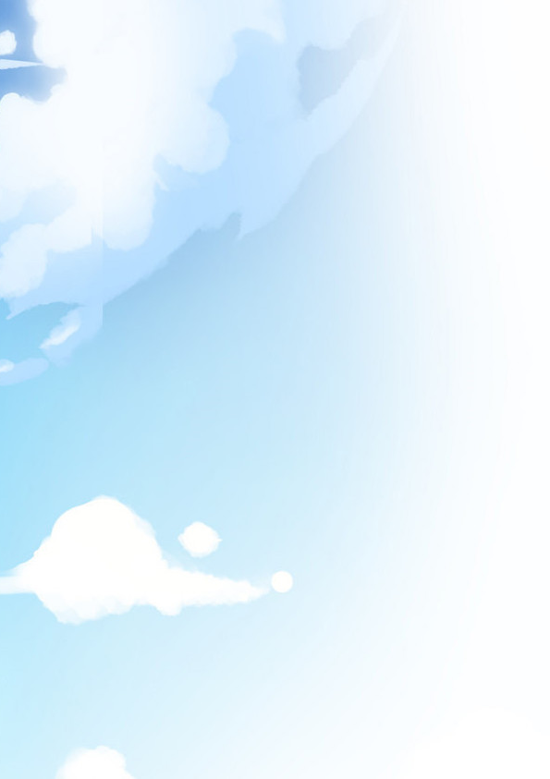

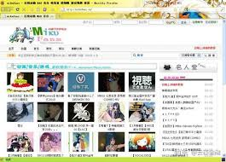

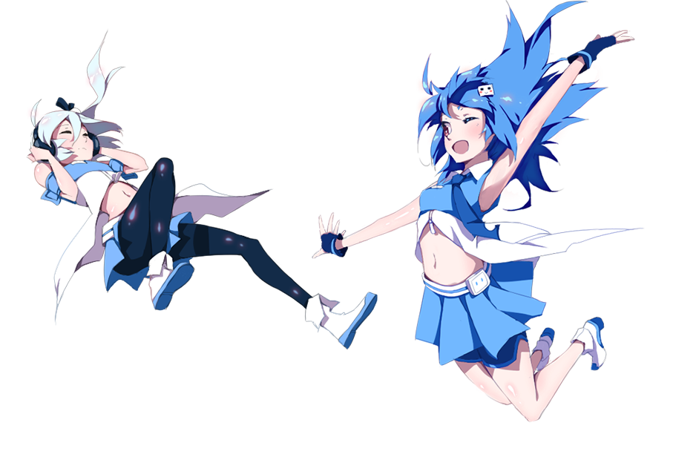
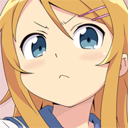
Background
Founded in 2009 June 26th
By ⑨bishi
Originally called Mikufans
Current CEO is Rui Chen
Changed name in 2010 January 24
22 & 33

Slide 5
Marketing
The faithfulness of consumers to a particular brand as shown by their repeat purchases irrespective of the marketing pressure from competing brands
A factor that differentiates a product from its competitors. A USP could be thought of as ‘what you have that competitors don’t’
Market growth
Target Market
Niche Marketing
Unique Selling Point
Brand Loyalty
Identifying and exploiting a small segments of a large market by developing products to suit it
The percentage change in the total size of a market (volume or value) over a period of time.
Focusing Marketing activity on particular segments of the market

Slide 6
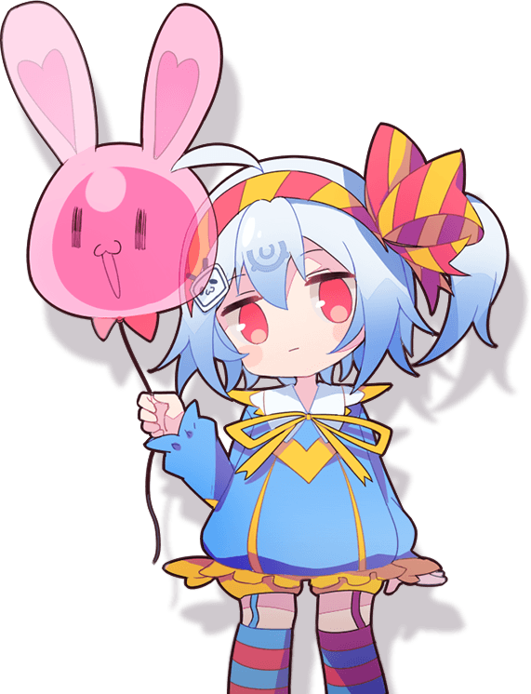

Innovation

Slide 7
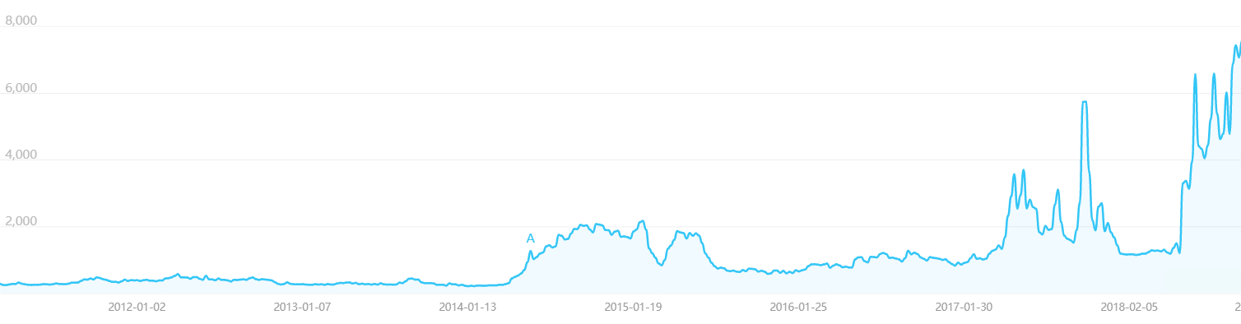
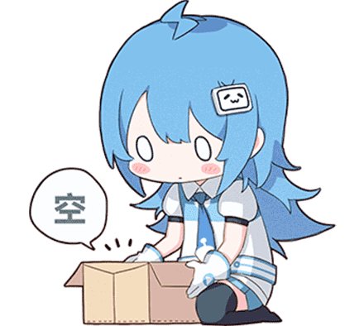
Target Market
Anime Community
Niche market
Small but growing

Slide 8
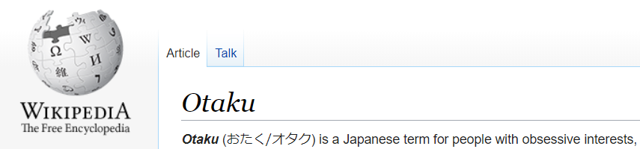
Otaku
Notes:
Otaku are people who are overly obsessive with their interest
Often looked down by the society:

Slide 9
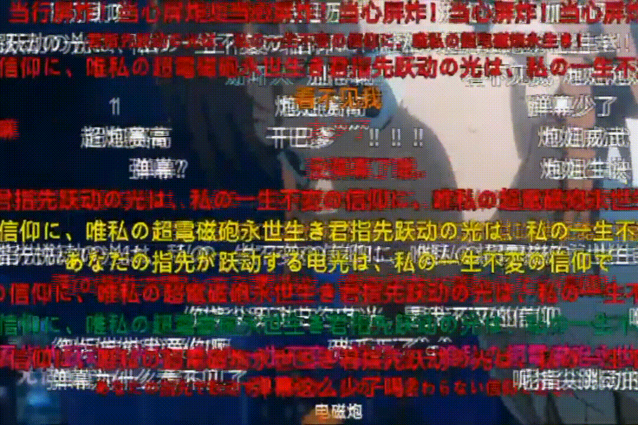
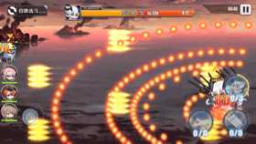
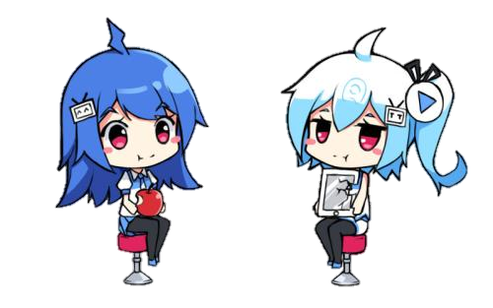
Dan-maku 弾 幕
guess they never miss huh
guess they never miss huh
guess they never miss huh
guess they never miss huh
guess they never miss huh
guess they never miss huh
guess they never miss huh
Hit or miss?
guess they never miss huh
guess they never miss huh
guess they never miss huh
Originally the bullets in games
Became comments of videos
guess they never miss huh
guess they never miss huh
guess they never miss huh

Slide 10
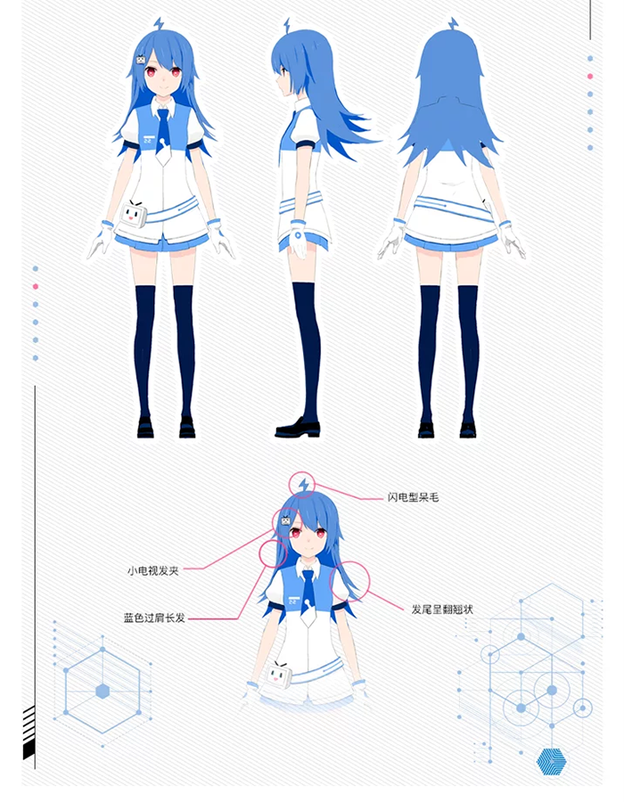
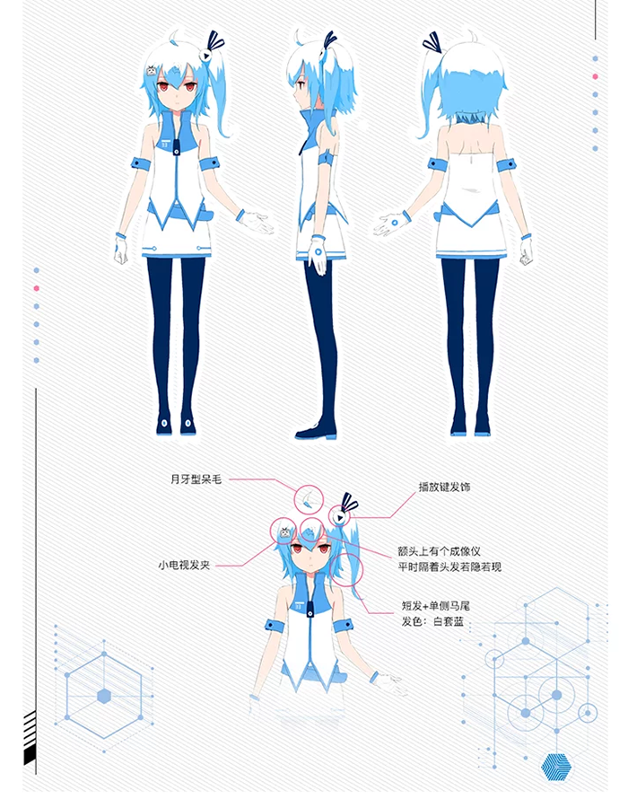
22 33

Slide 11
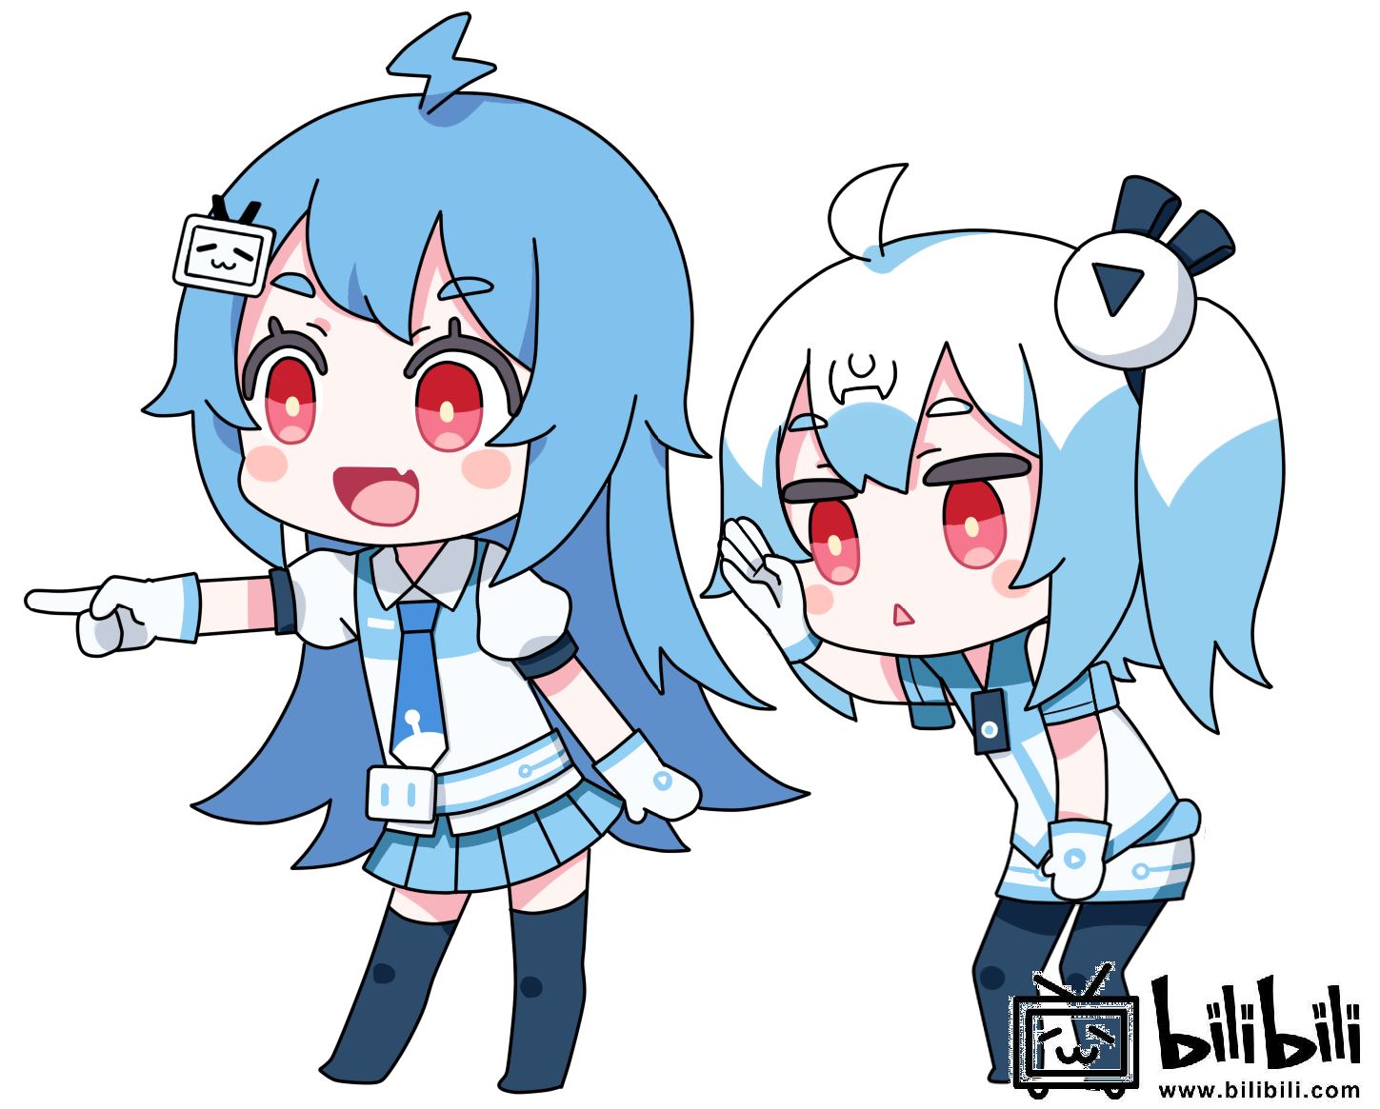
anthropomorphism
Characters representing the company
Voted in 2010
Very popular
Fit target market

Slide 12
Ads

Slide 13















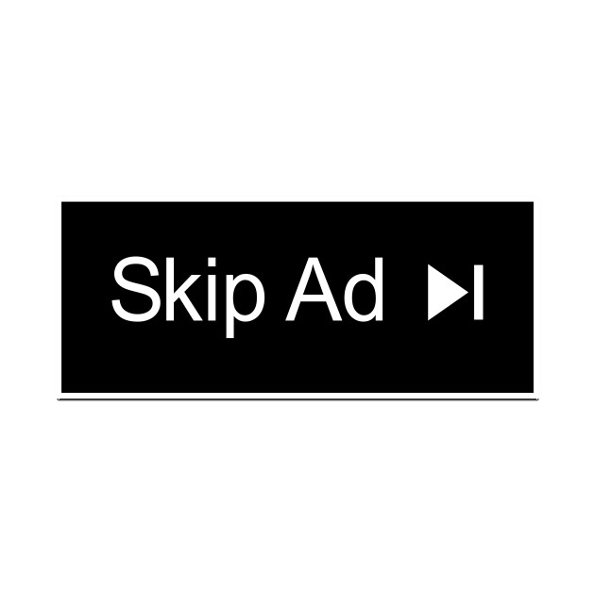
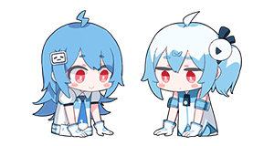
Ads
Mostly rely on ads
3-5 min un-skipable
＼(￣▽￣)／ NO ADS ON BIIBILI ＼(￣▽￣)／

Slide 15

Registration system
Invitation only
Take test → member
Nicknamed the online exam
Became easier

Slide 16
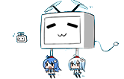
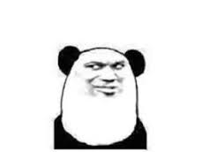
Benefits
Clean comments
Build community
Hard to join
Pride as a member

Slide 17
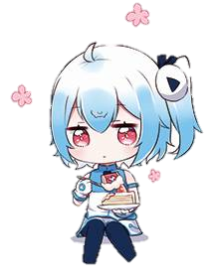
22 & 33
Significant difference
More likely to use Bilibili
Create value in brand
Brand loyalty

Slide 18
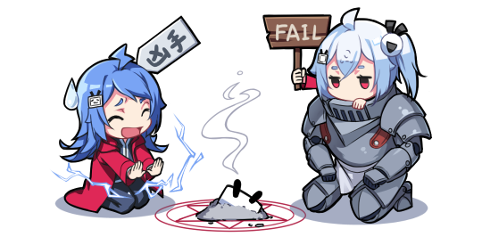
USP
Brand loyalty
Community – emotional connection
Monopoly of anime market

Slide 19

Viral marketing
Everyone talks about Bilibili
Spread with word
Memes created
Easily spread with 22 & 33
Pay to put up ads

Slide 20
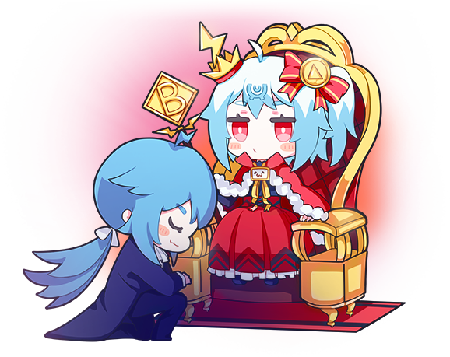
Ethics

Slide 21
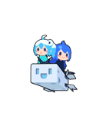
Disappointed users
Hard → Easy
Uneducated comments
Notes:
Test moved from hard to easy
Lots of low age kids that do not know how to behave joined

